Slide 1
Non-IID Representation Learning for Complex Data
Chengzhang Zhu
Advanced Analytics Institute
University of Technology Sydney

Slide 2






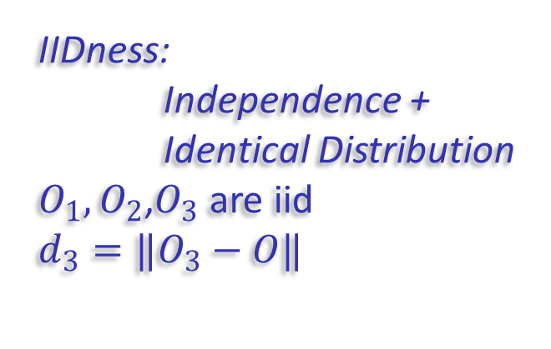


Classic Assumption – IIDness & IID Learning
IID Learning:
Dominates classic analytics,
AI/KDD/ML/CVPR/Statistics research & development
Solution
$$O_{2}$$
$$O_{1}$$
$$d$$
$$O$$
$$O_{2}$$
$$O_{3}$$
$$O_{1}$$
IIDness:
Independence +
Identical Distribution
$O_{1}, O_{2}$,$O_{3}$ are iid
$$d_{3}=‖O_{3}−O‖$$
$$O_{3}$$
Problem

Slide 3
Non-IIDness in Complex Data
Heterogeneity:
Data types, attributes, sources, aspects, …
Formats, structures, distributions, relations, …
Learning outcomes
Coupling relationships:
Within and between values, attributes, objects, sources, aspects, …
Structures, distributions, relations, …
Methods, models, …
Outcomes, impact, …
Not identically distributed
Non-IIDness
Not independent

Slide 4
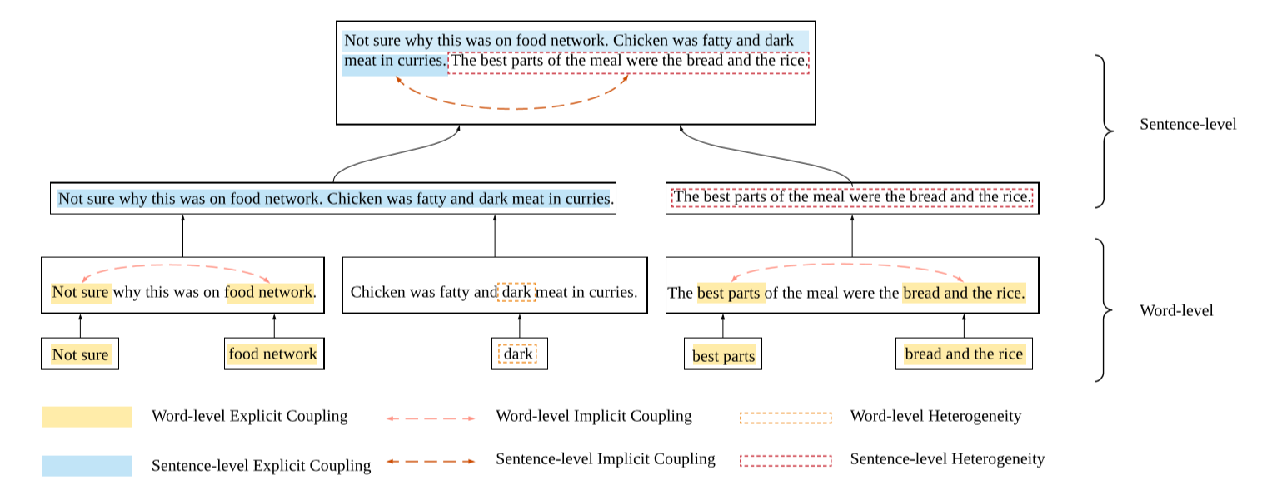
Example of Non-IID Data Complexity

Slide 5









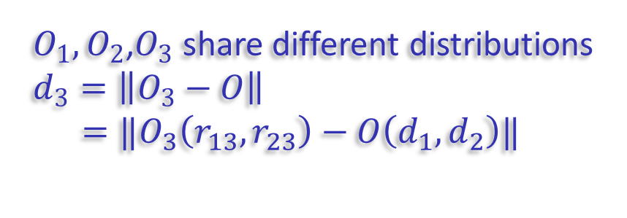




Non-IID Representation Learning
Problem
$$O_{2}$$
$$O_{1}$$
$$O_{3}$$
$$O_{2}$$
$$r_{12}$$
$$d_{2}$$
$$r_{23}$$
$$O_{1}$$
$$d_{3}$$
$$d_{1}$$
$$O$$
$O_{1}, O_{2}$,$O_{3}$ share different distributions
$$d_{3}=\left\|O_{3}−O\right\|$$
$=‖O_{3}\left(r_{13},r_{23}\right)−O\left(d_{1}, d_{2}\right)‖$
$$r_{13}$$
$$O_{3}$$
Solution

Slide 6
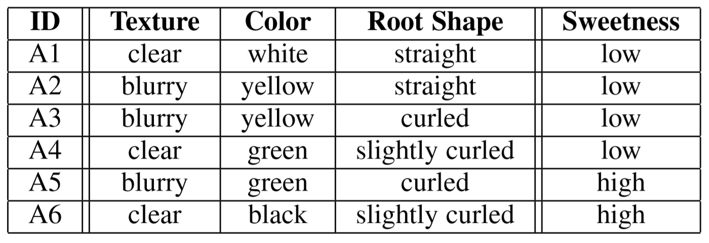
Non-IID Metric Learning for Categorical Data
Motivation
Hamming distance: $Dis_{h}\left(straight, curled\right)=Dis_{h}\left(straight, slightly curled\right)=1$
Curled shape is closer to slightly curled shape instead of straight shape.
Frequency-based distance: $Dis_{f}\left(straight, curled\right)=0$
Straight shape is different from curled shape.

Slide 7
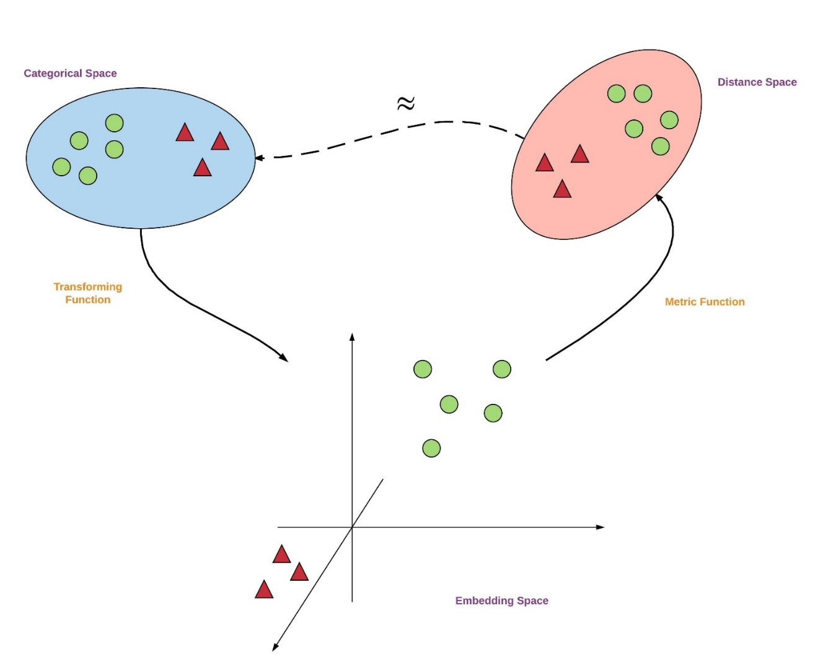
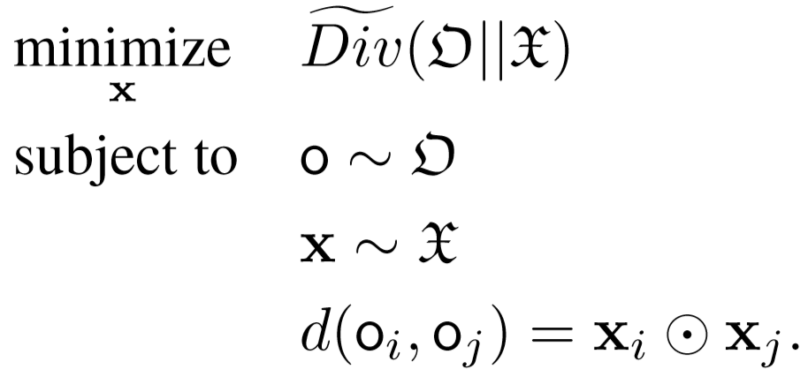
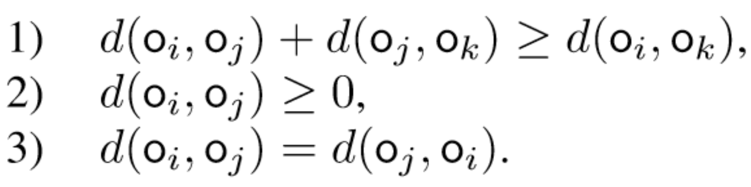







Non-IID Metric Learning for Categorical Data
Problem Statement
$$x_{j}$$
$$𝔒$$
$$o_{j}$$
$$o_{i}$$
$$x_{i}$$
$$𝔛$$
Distance metric $d(⋅,⋅)$ satisfies:
Zhu, Chengzhang, et al. "Heterogeneous metric learning of categorical data with hierarchical couplings." IEEE Transactions on Knowledge and Data Engineering 30.7 (2018): 1254-1267.

Slide 8
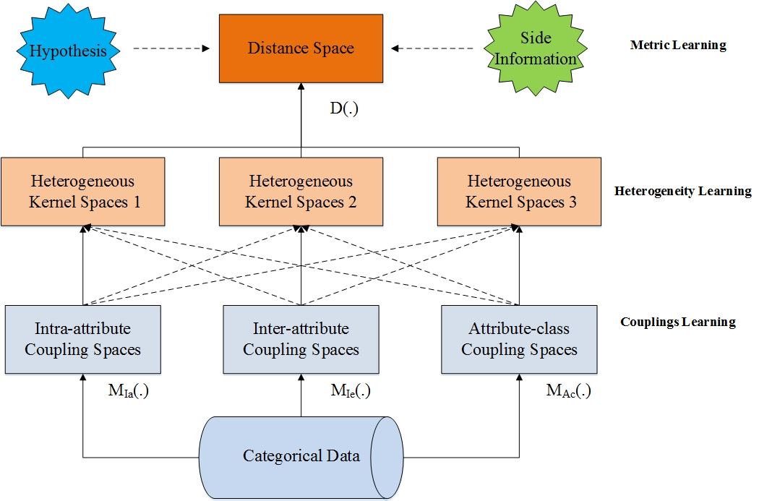
Non-IID Metric Learning for Categorical Data
HELIC Framework
Prior/ Implicit
Observed/ Explicit
HELIC: Heterogeneous Metric Learning with hIerarchical Couplings

Slide 9
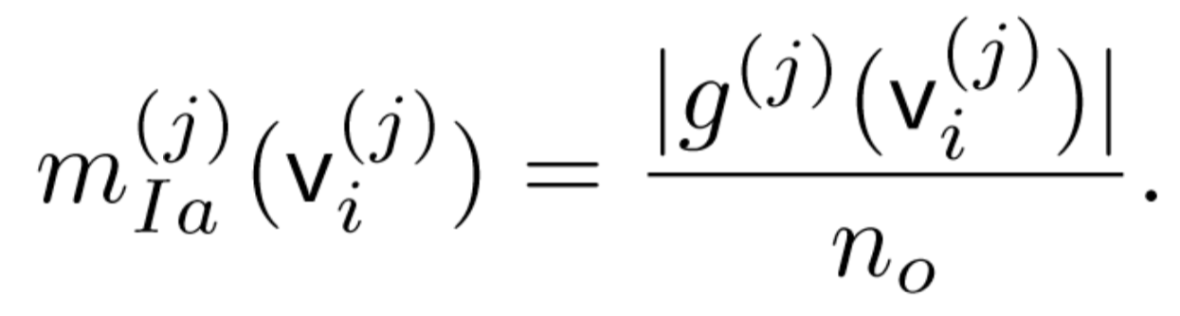
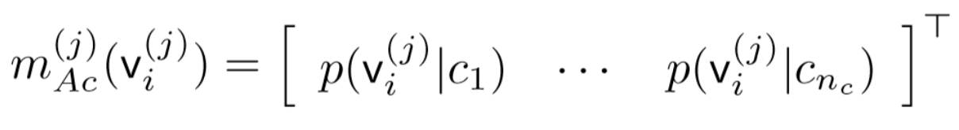
Non-IID Metric Learning for Categorical Data
Learning Value-to-Class Couplings
Learning Intra-attribute Couplings
Capture value frequency
Capture values co-occurrence
Learning Inter-attribute Couplings
Capture value distribution in each class
Learning Attribute-class Couplings

Slide 10
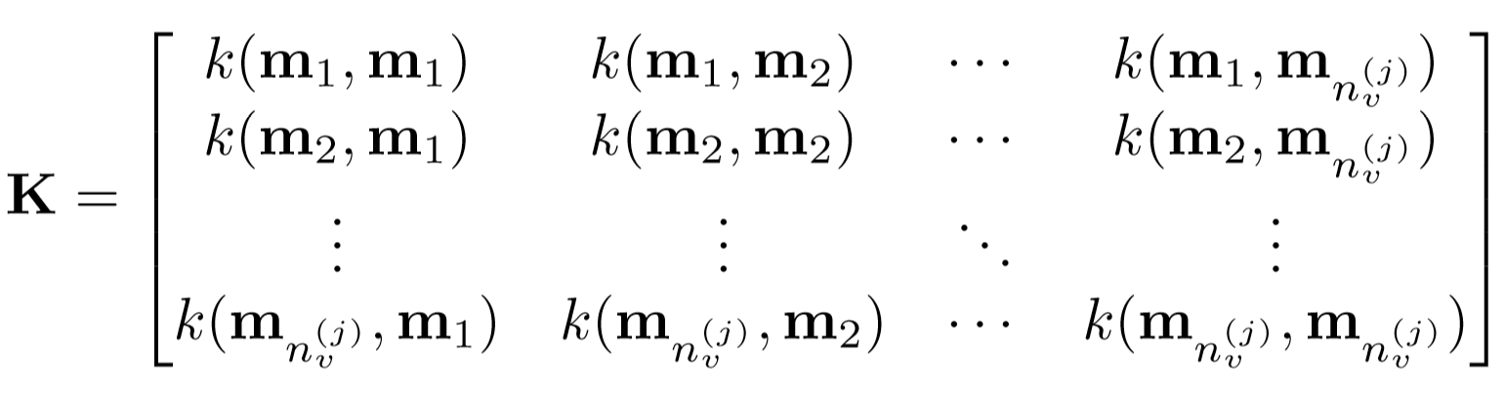
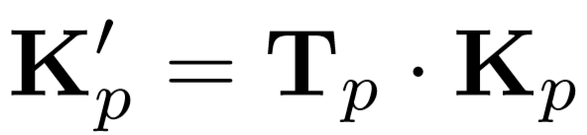
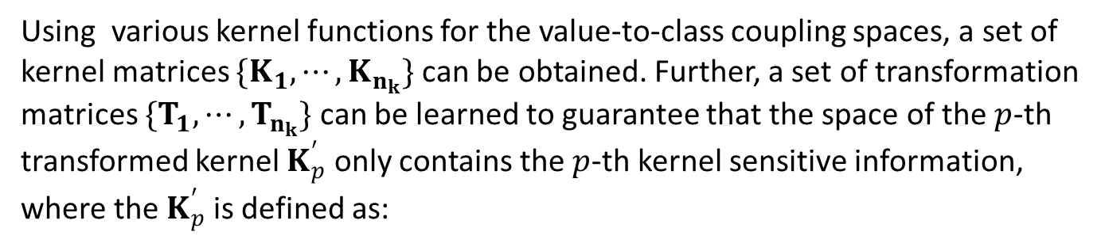
Non-IID Metric Learning for Categorical Data
Heterogeneity Learning
Construct Kernel Space
Using various kernel functions for the value-to-class coupling spaces, a set of kernel matrices ${\{K}_{1}, ⋯,K_{n_{k}}\}$ can be obtained. Further, a set of transformation matrices $\{T_{1},⋯,T_{n_{k}}\}$ can be learned to guarantee that the space of the $p$-th transformed kernel $K_{p}^{′}$ only contains the $p$-th kernel sensitive information, where the $K_{p}^{′}$is defined as:

Slide 11


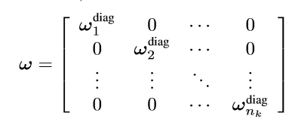



Non-IID Metric Learning for Categorical Data
Metric Learning
The distance between two categorical data in a kernel space then equals to a squared Mahalanobis distance:
The distance metric between two categorical data is defined by a linear combination of base distance measures from heterogeneous kernel spaces:
With a positive semi-definite matrix $ω_{p}=α_{p}T_{p}^{⊤}T_{p}$, the metric $d_{ij}$ is calculated as :
where $k_{p,ij}=K_{p,i⋅}−K_{p,j⋅}$
The distance can be represented as

Slide 12
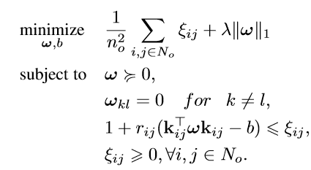
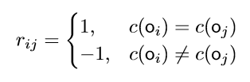
Non-IID Metric Learning for Categorical Data
Metric Learning
Objective function:
Selecting the kernels for their sensitive data distribution
Force the distance between objects from different classes large than a margin

Slide 13
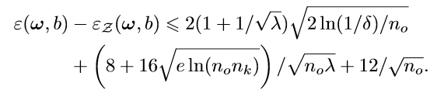


Non-IID Metric Learning for Categorical Data
Theoretical Analysis
Generalization Error Bound
Time Complexity
$$O\left(n_{v}\left(n_{c}+1\right)+n_{mv}^{2}n_{a}^{2} + n_{b}n_{ω}n_{step}\right)$$
Space Complexity
$$O\left(n_{b}n_{ω}\right)$$

Slide 14
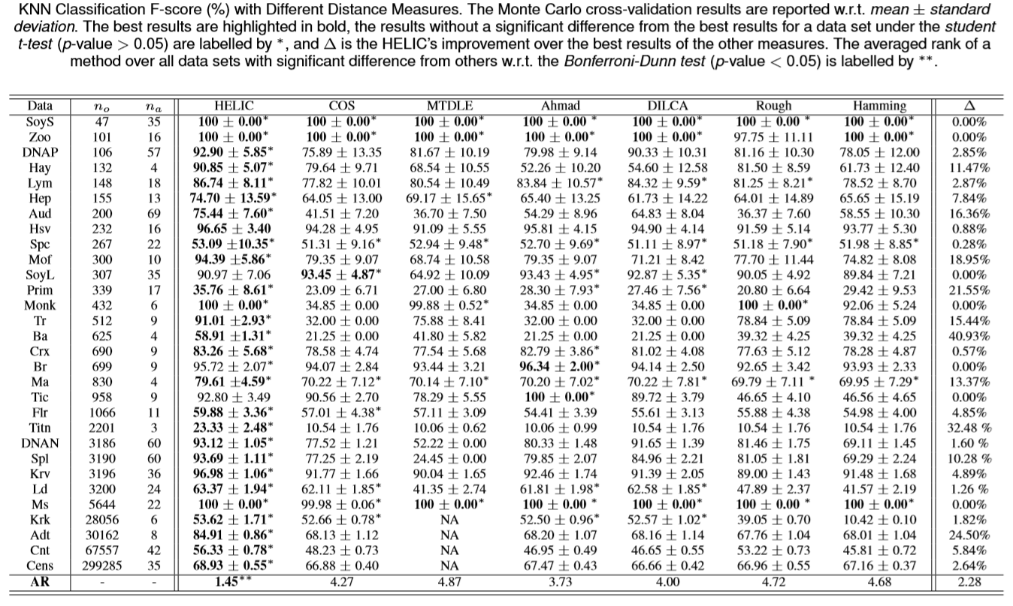
Non-IID Metric Learning for Categorical Data
Representation Performance of HELIC

Slide 15
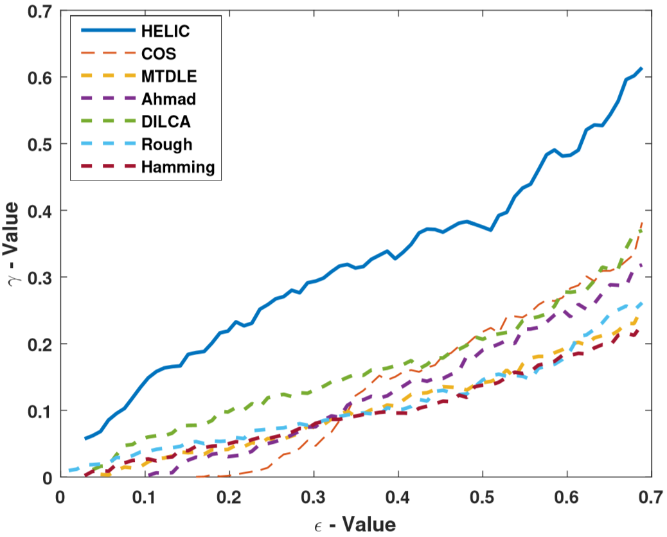
Non-IID Metric Learning for Categorical Data
Representation Quality of HELIC

Slide 16
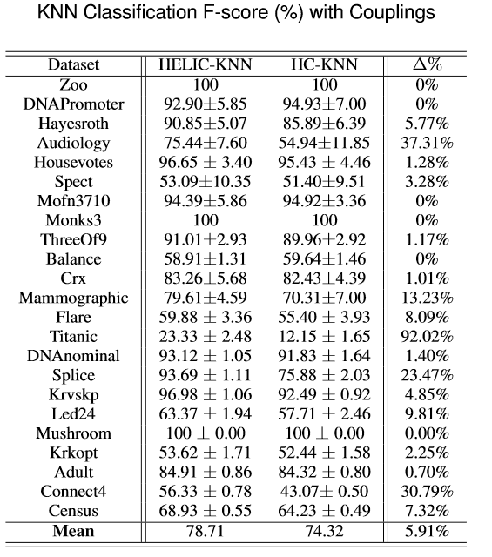
Non-IID Metric Learning for Categorical Data
Classification Performance
HC：only learn the hierarchical couplings.
HELIC: learn both hierarchical couplings and heterogeneity

Slide 17
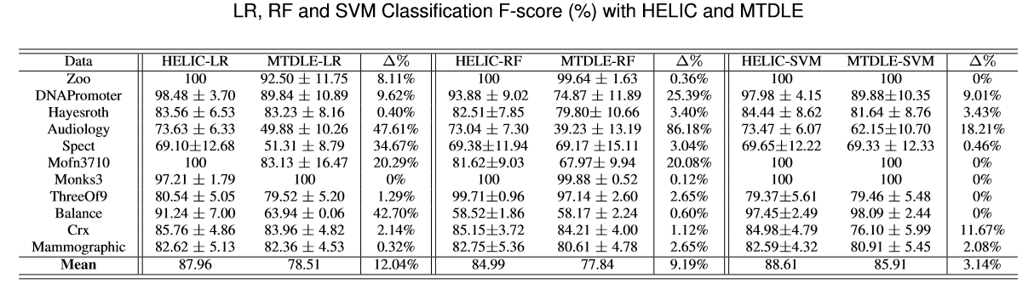
Non-IID Metric Learning for Categorical Data
Flexibility of HELIC

Slide 18
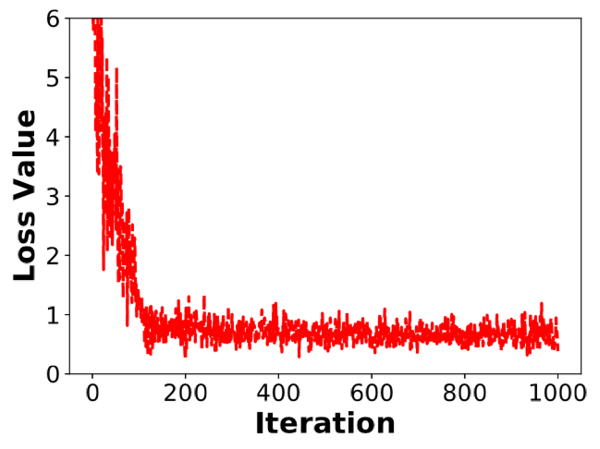
Non-IID Metric Learning for Categorical Data
Scalability of HELIC

Slide 19
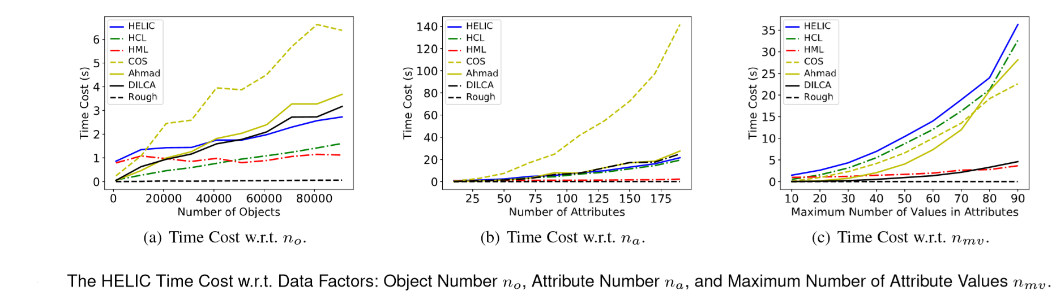
Non-IID Metric Learning for Categorical Data
Scalability of HELIC

Slide 20
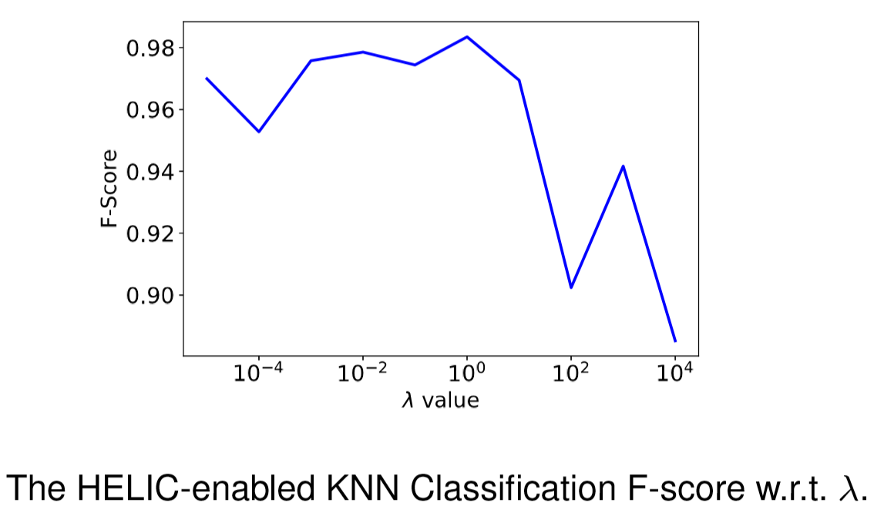
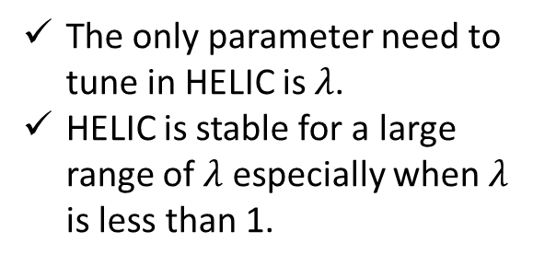
Non-IID Metric Learning for Categorical Data
Stability of HELIC
The only parameter need to tune in HELIC is $λ$.
HELIC is stable for a large range of $λ$ especially when $λ$ is less than 1.

Slide 21
Non-IID Metric Learning for Categorical Data
Conclusion
This work reports an effective heterogeneous metric for learning hierarchical couplings within and between attributes and between attributes and classes in categorical data.
It analyzes the heterogeneity in the hierarchical interaction spaces and integrating heterogeneous couplings in complex categorical data.
The proposed method can be applied to a variety of areas with categorical data. One thing in applications is to select appropriate kernels by considering specific data characteristics and domain knowledge of the problems.

Slide 22
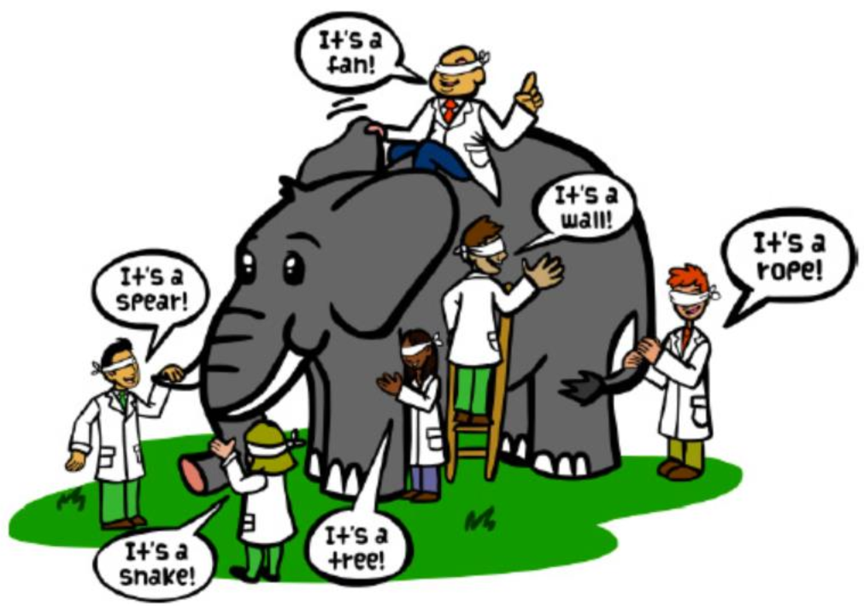
Conclusion
How can blind people tell a genuine story about elephant?
Non-IID Representation Learning?
Couplings between parts
Heterogeneity between parts
Local – global picture
(know → unknown)

